Slide 1
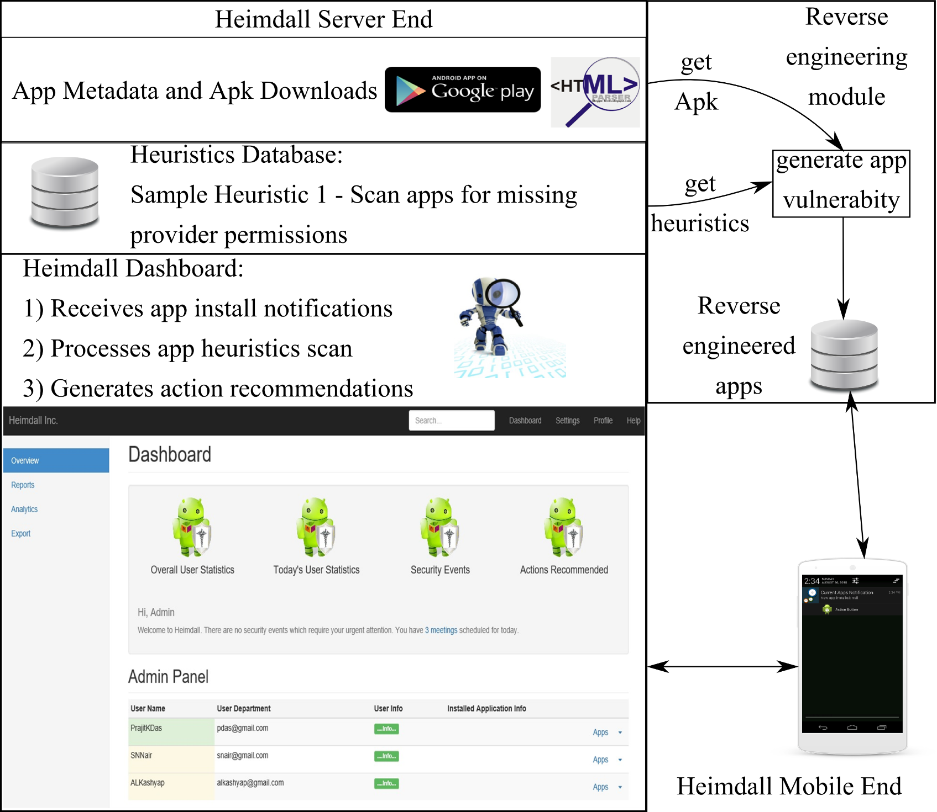
System Architecture
Notes:
We are presenting an end to end system now.
The vulnerabilities being studied is partially automated.
We are able to analyze the apps code but generating heuristics is based on our studies and understanding of Android’s security.
We have one heuristic feature right now and are developing more such heuristics.
The reverse engineering module is for validation of heuristics we found.
The mobile end of the app executes the rules “sent” by the admin server.

Slide 2
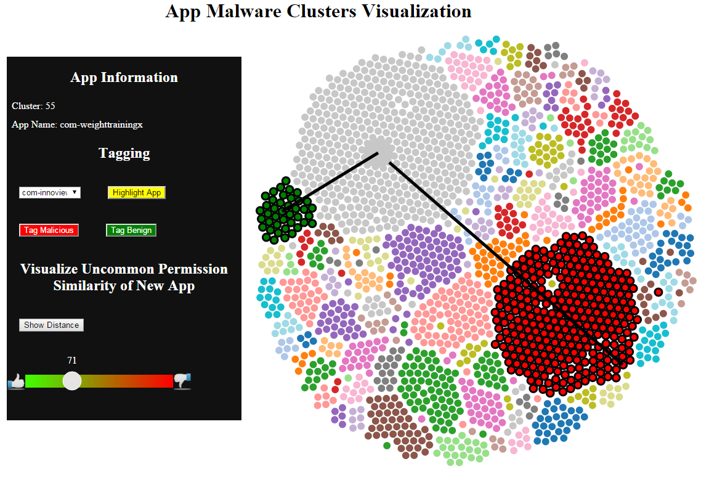
Analytics and Visualization
Notes:
Clustering was used to determine similarity to malware apps and if so maybe used as a strong indication of potential malicious behavior.

Slide 3
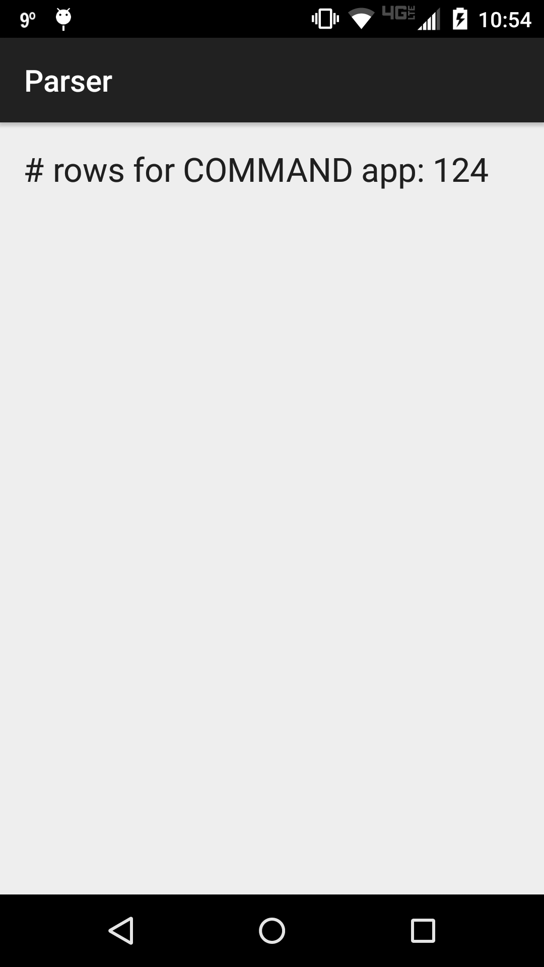
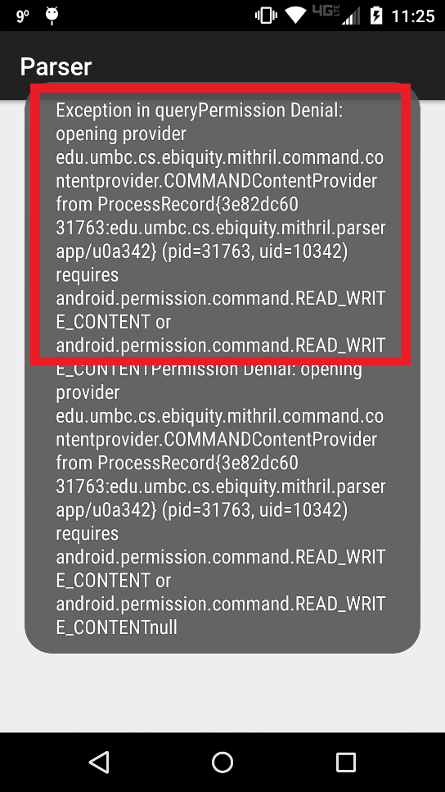
Content Provider Vulnerability: A Heuristics Based Approach
Content Provider app | Content accessing app | Remark
No permission associated with provider | No permission used | Potential data leakage
No permission associated with provider | Permission used | Potential data leakage
Permission associated with provider | No permission used | Permission denied
Permission associated with provider | Permission used | Ideal scenario
Android Lollipop
Android content provider permission doesn’t exist and but dummy permission used
Android content provider permission doesn’t exist and no permission used
Android content provider permission exists and accessed
with permission
Permission denial

Slide 4
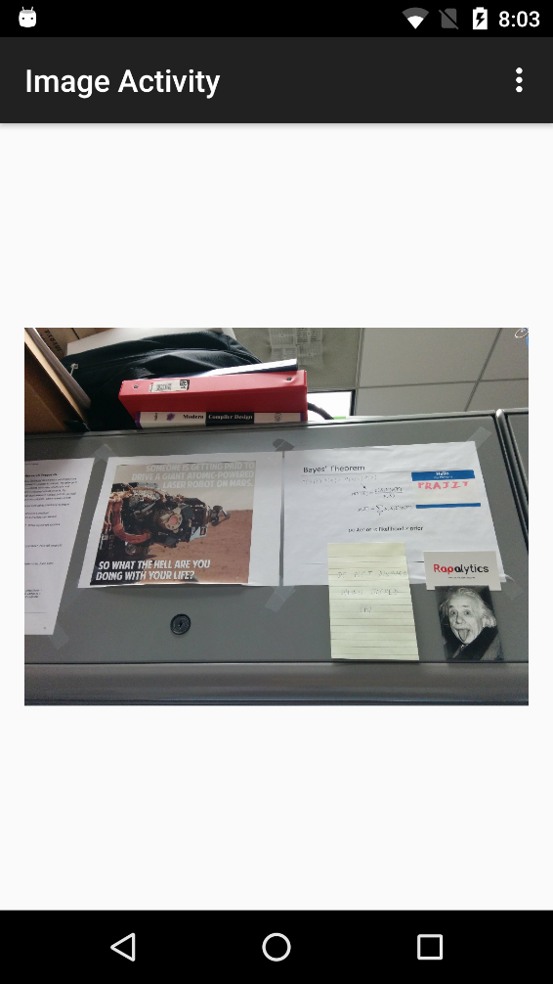
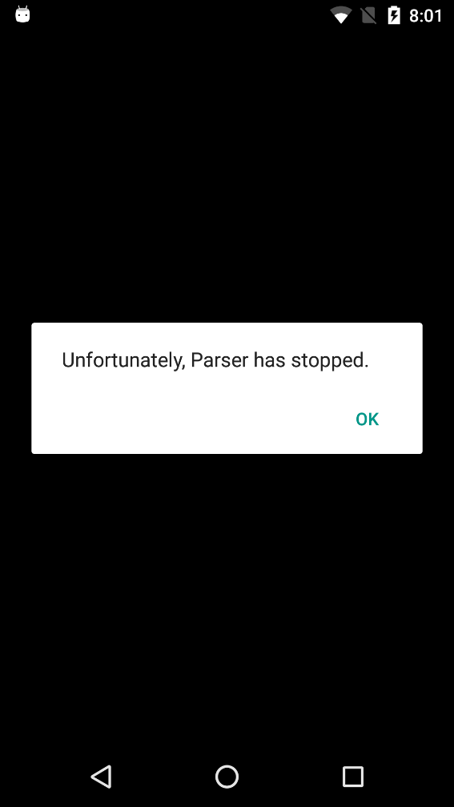
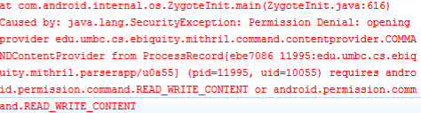
Content Provider Vulnerability: A Heuristics Based Approach
Content Provider app | Content accessing app | Remark
No permission associated with provider | No permission used | Potential data leakage
No permission associated with provider | Permission used | Potential data leakage
Permission associated with provider | No permission used | Permission denied
Permission associated with provider | Permission used | Ideal scenario
Android Marshmallow
Android content provider permission doesn’t exist and no permission used
Android content provider permission doesn’t exist and but dummy permission used
Android content provider permission exists and accessed
with permission
Permission denial

Slide 5
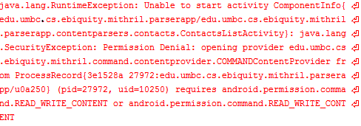
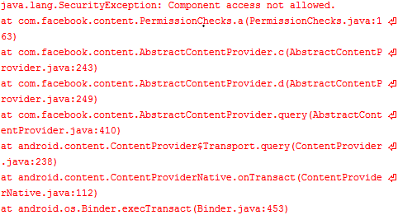
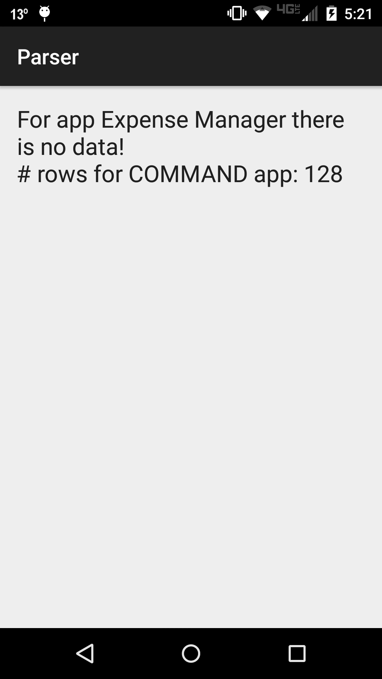
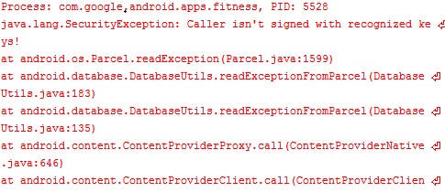
What security? “Custom security”
Standard Protection
Hacky protections: Facebook
Hacky protections: Google
No check points were found on a less popular app
Notes:
Only custom security exists for content providers we want to change that

Slide 6
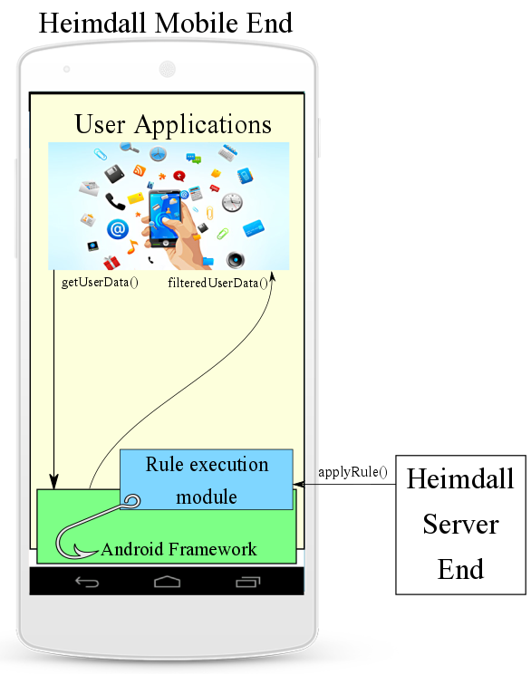
Access Control Policies
Rule execution module is our “hook” in the Framework
Business logic or Access Control policy is handled by Sys Admin
Heimdall server controls data security and privacy on “Hemidall enabled phones”
Periodically exchanges policies to keep devices safe
Notes:
The rule execution module is partially part of the Android Framework as part of our “hook” coding.
It can control the data flow because at least for the dangerous permissions the apps would have to go through the permission control as of Marshmallow and we are incorporating our Business Logic in that module to ensure that our policies are respected

